Slide 1
Transparent Image Layer Diffusion using Latent Transparency
Lvmin Zhang and Maneesh Agrawala
Stanford University
arXiv:2402.17113v1 [cs.CV] 27 Feb 2024

Slide 2
Hiding Images inside Perturbations
In this paper, “latent transparency” utilizes similar principles: hiding image transparency features inside a small perturbation added to the latent space of Stable Diffusion [43], while at the same time avoiding changes to the overall distribution of the latent space.

Slide 3
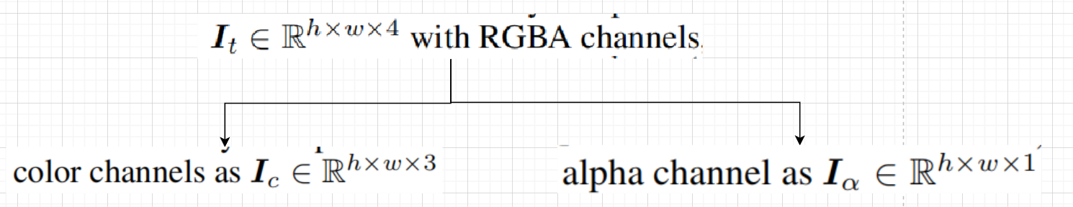
Method
Introduce the method to adjust the LDM latent space to support transparent image encoding/decoding.
Definitions
Transparent image:

Slide 4
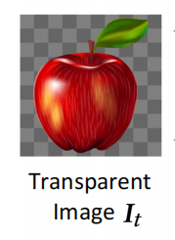
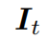
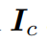
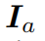
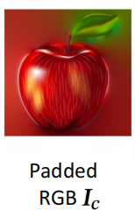
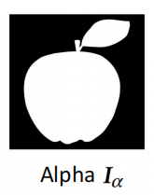
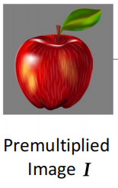
Images,
the original images with alpha channel
padded by an iterative Gaussian filter
avoid aliasing and unnecessary edge patterns
RGB values are in range [−1, 1]
aphla channel between [0,1]
premultiplied image: non-transparent RGB image

Slide 5
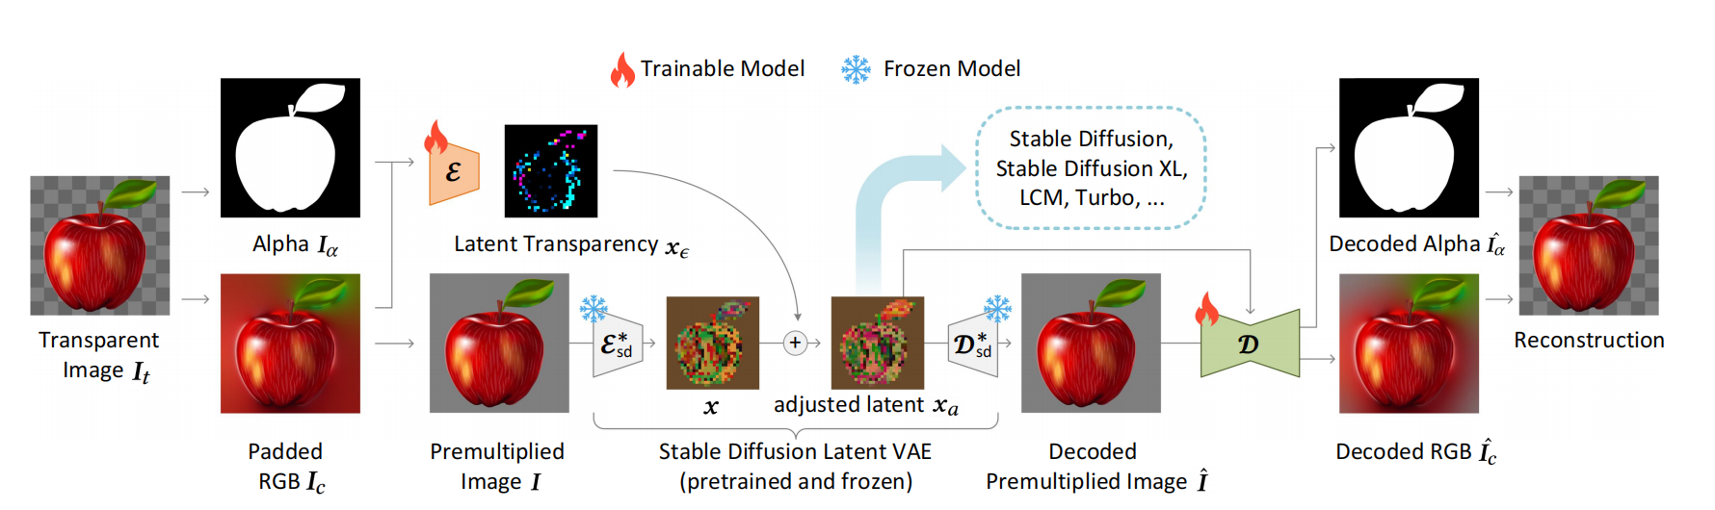
Transparent Image Processing

Slide 6
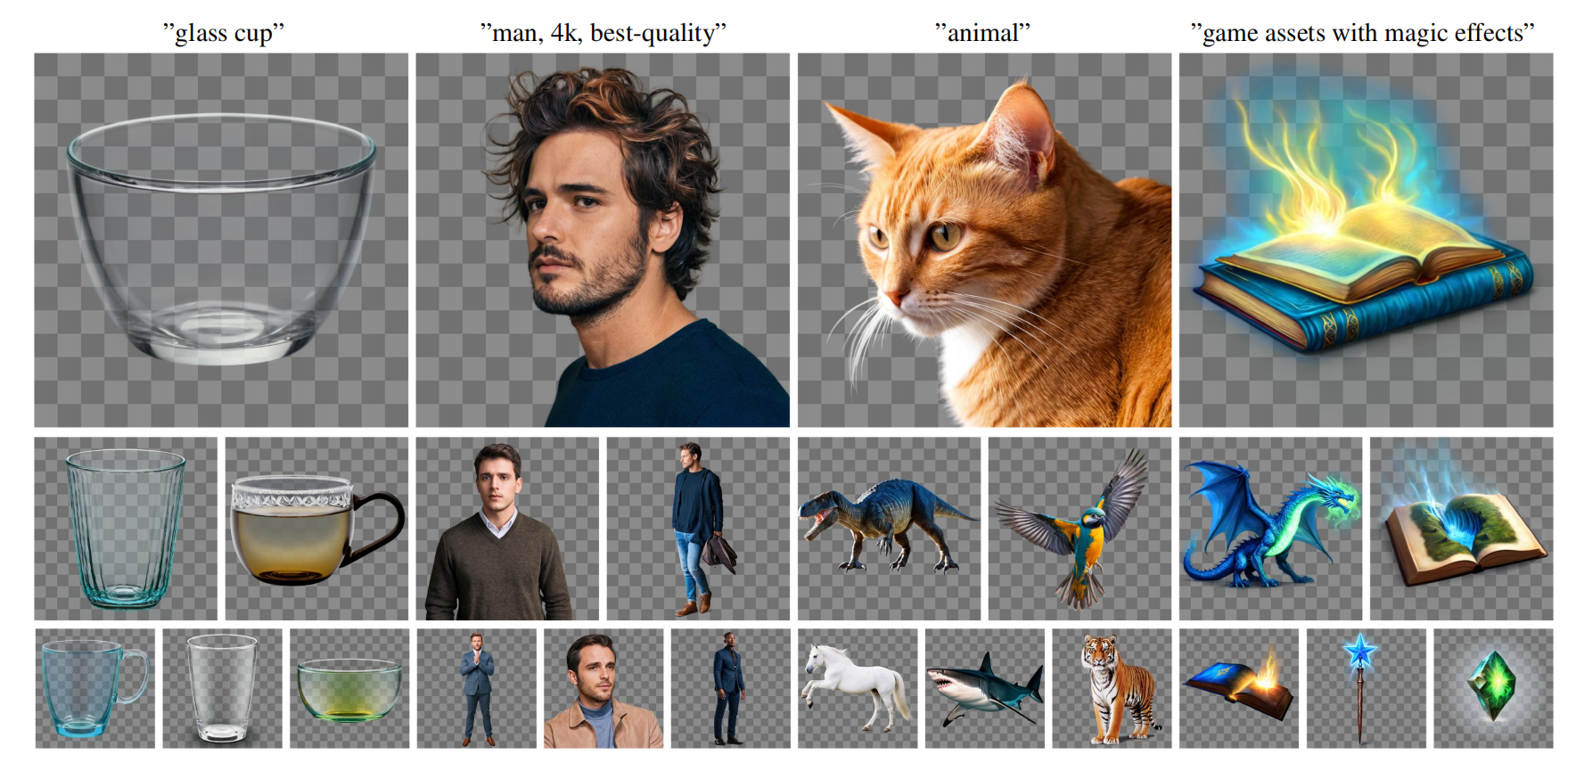
Base model
Able to generate object with transparent backgournd
Examples:

Slide 7
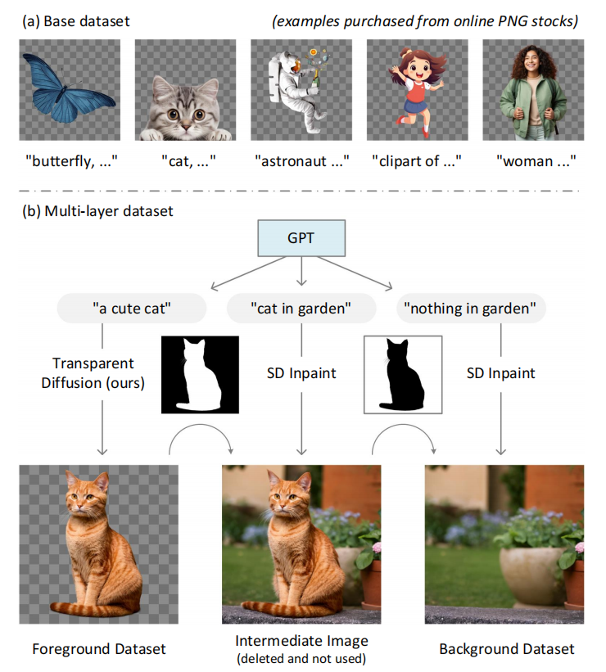
Extends the base dataset to Multi-layer Dataset
Collect relative background using GPT + SD inpaint

Slide 8
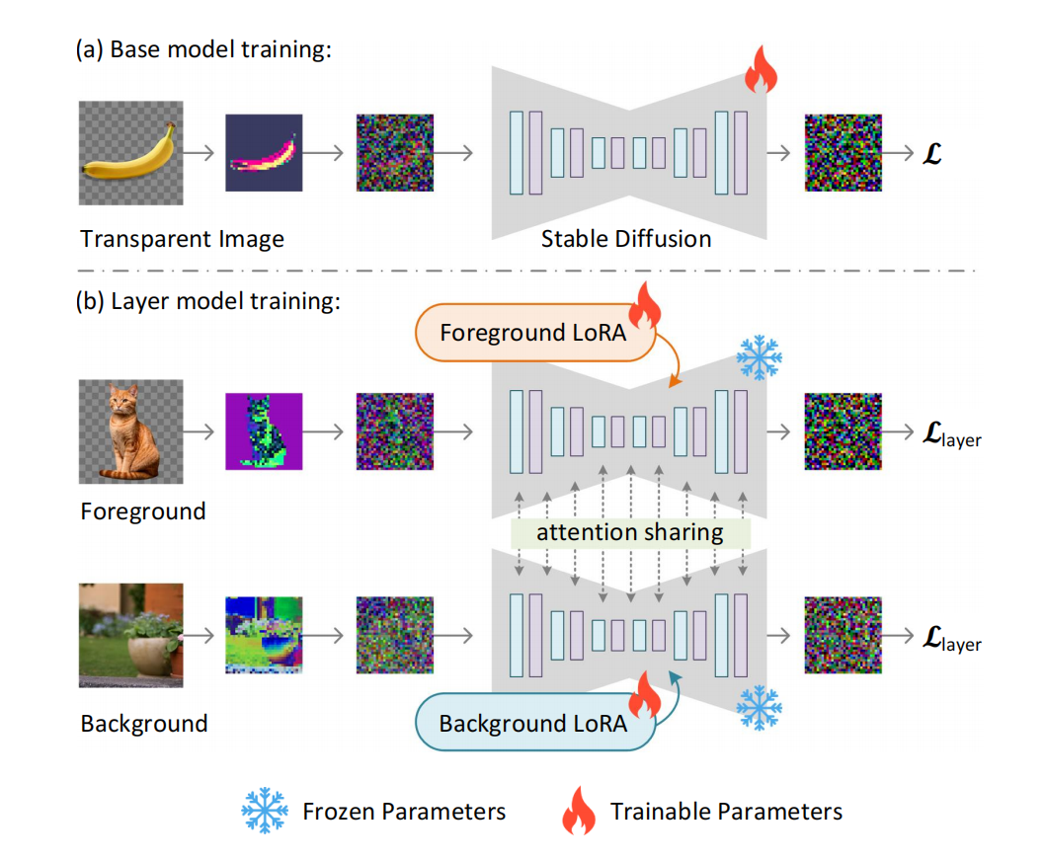
Model Training
First trained base model with all weight
Extended the trained for foreground and background

Slide 9
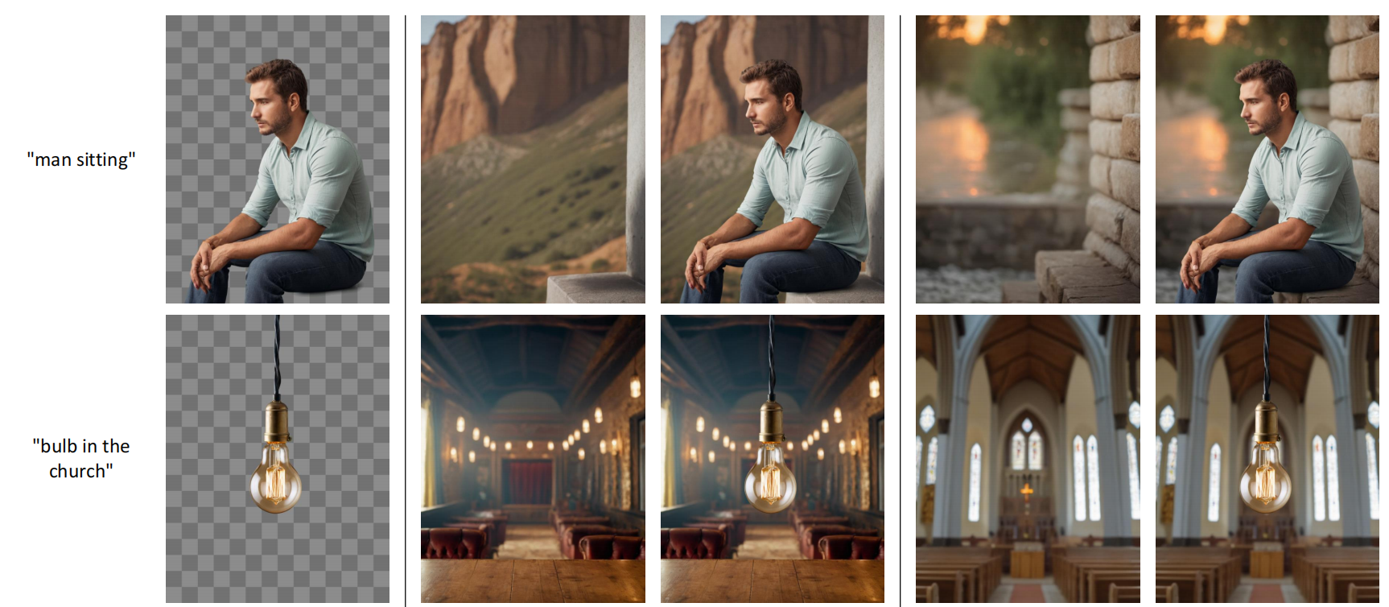
Conditional Layer Generation
foreground-conditioned background

Slide 10
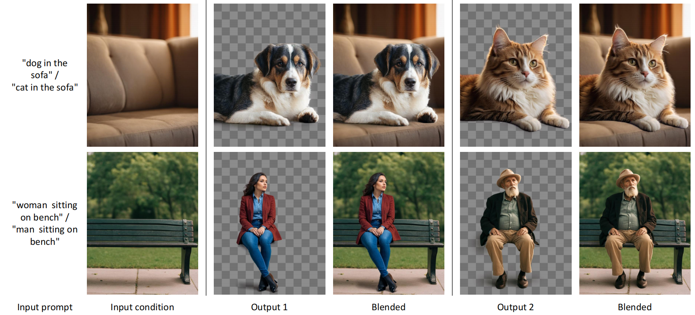
Conditional Layer Generation
background-conditioned foreground

Slide 11
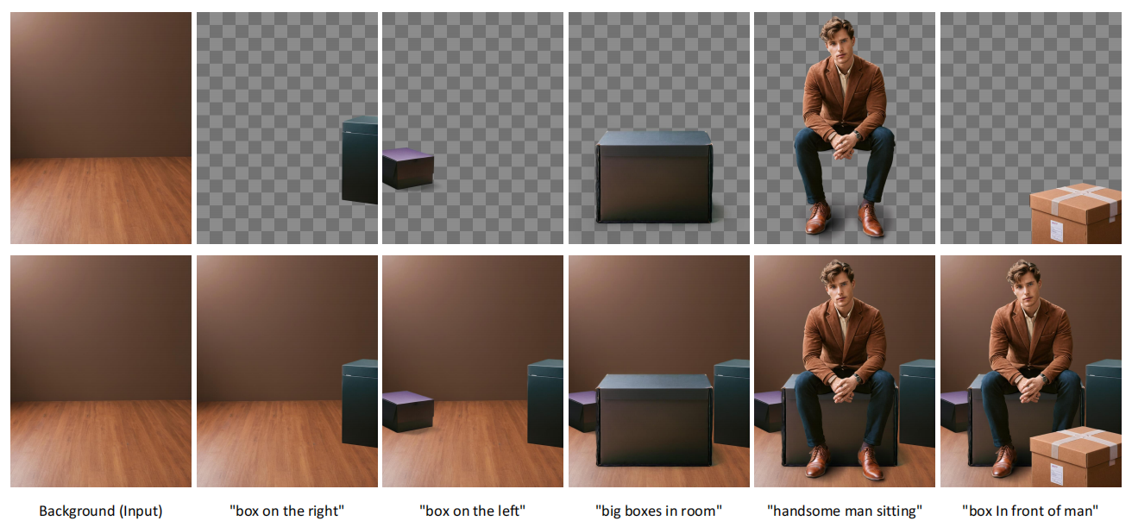
Generating Multiple Layers
multiple layers iteratively
repeating the background-conditioned foreground model

Slide 12
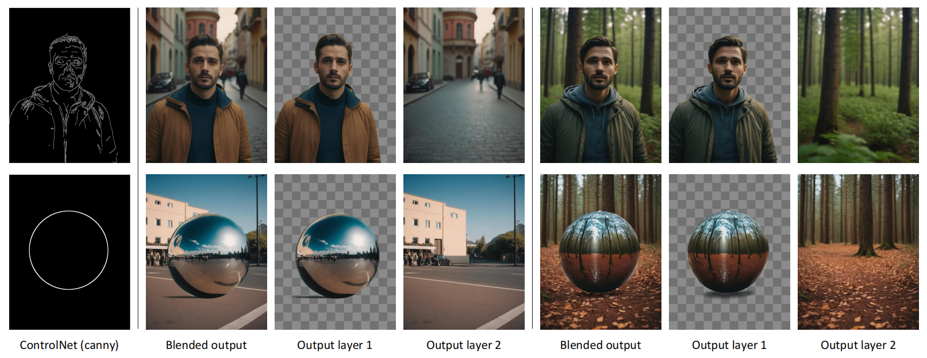
Conditional Layer Generation
Combining with Control Models

Slide 13
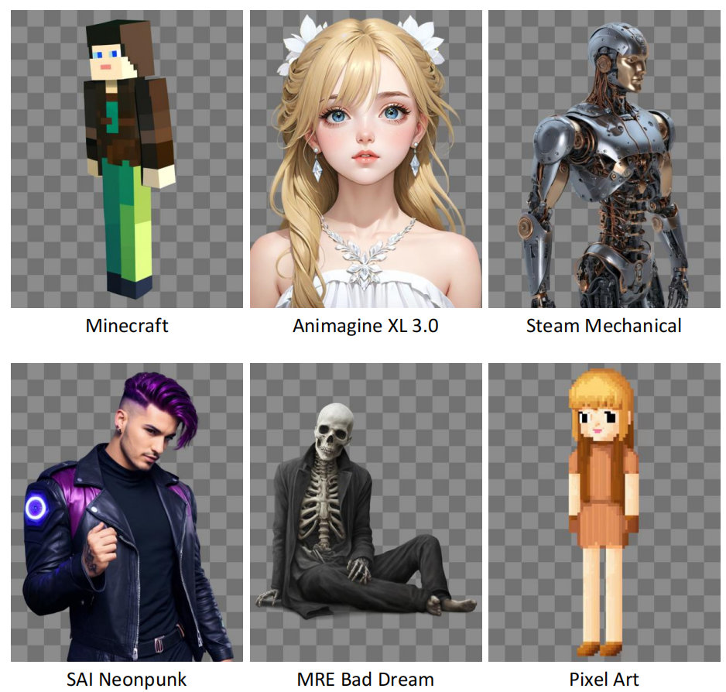
Community Models
No additional training to apply on community models

Slide 14
End
Thanks for watching

